Slide 1

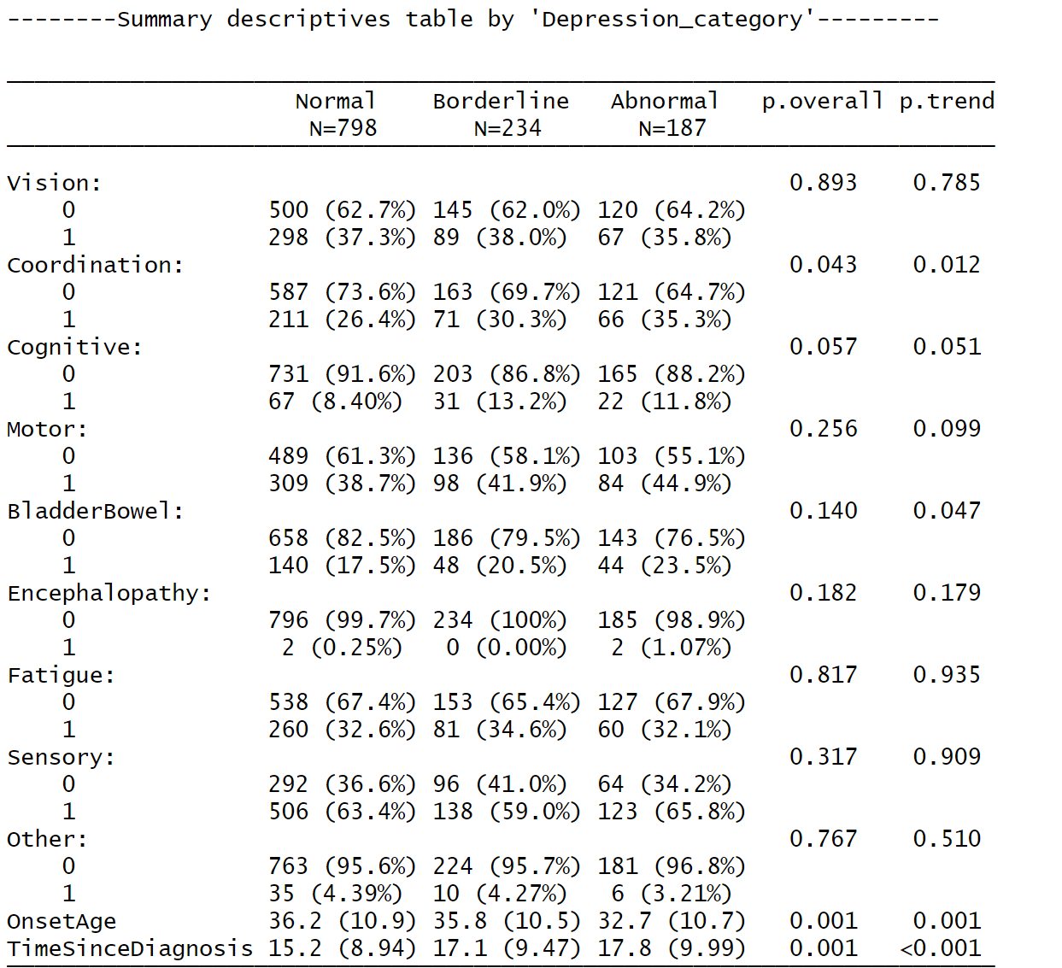
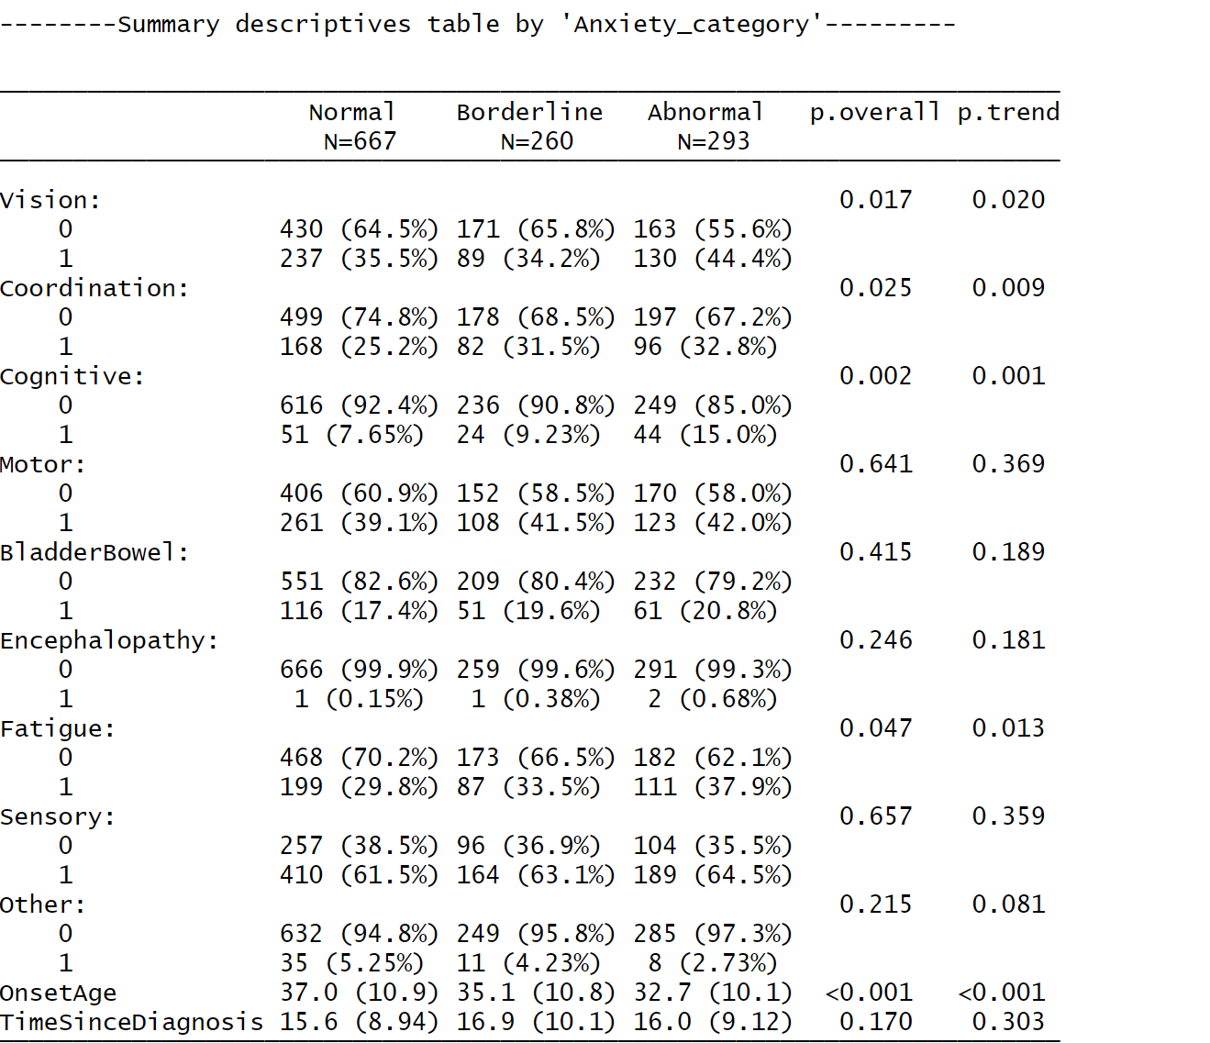
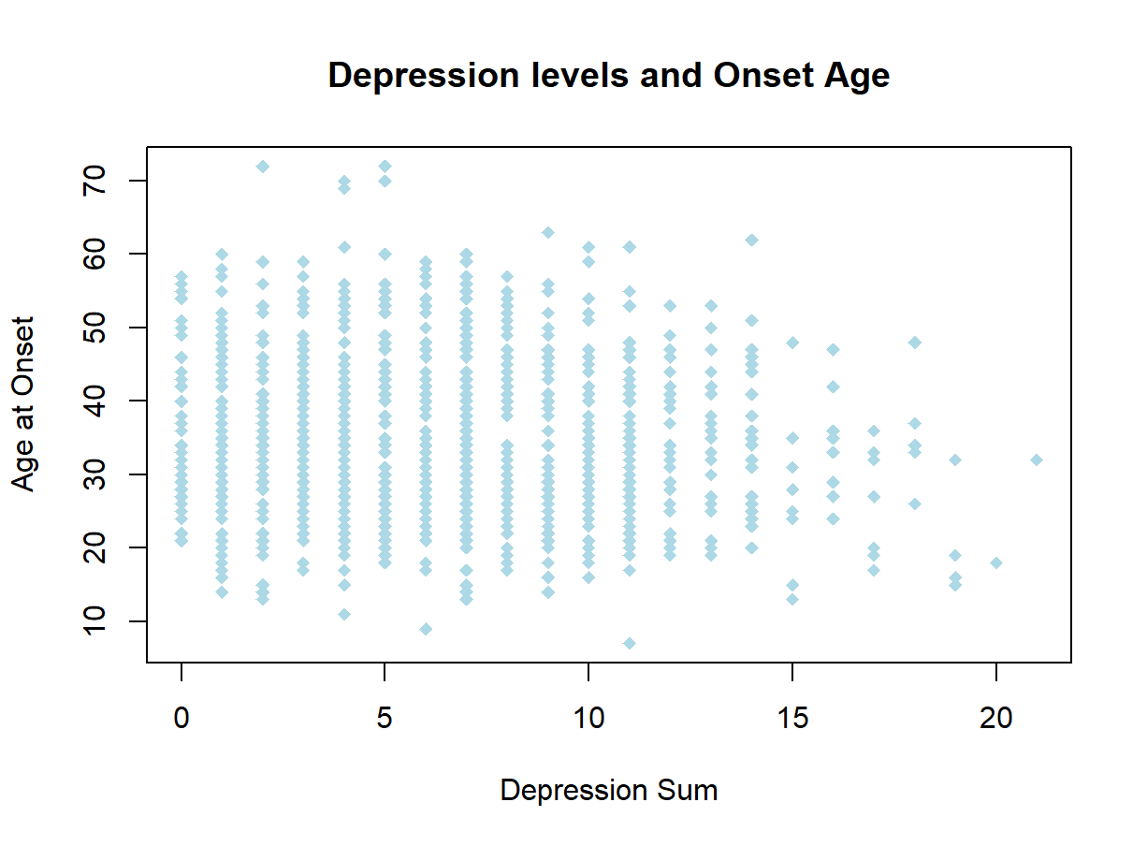



.
Exploring the relationship between early MS symptoms and psychological symptoms.
Introduction
Results
A significant incidence and prevalence of psychological symptoms have been reported in patients with early-onset MS symptoms.
Depression and Anxiety are common psychological symptoms in MS even before diagnosis.
These two symptoms have a remarkable frequency in MS and could influence the progression of MS.
Methodology
A longitudinal cohort was selected from the UKMSR that includes the population's demographics and symptoms.
Anxiety and depression were measured using the Hospital Anxiety and Depression Scale (HADS). HADS total score ranges from 0 – 21 and stratified into ‘Normal’ (0-8), ‘Borderline’ (8-13), and ‘Abnormal’ (14-21).
Statistical analysis was performed using R. The sample and summarised data were described using descriptive statistics (mean and standard deviation).
Discussion
Onset Age decreases with higher levels of anxiety and depression. There is a progression from normal to abnormal anxiety and depression levels as the onset age decreases. Additionally, earlier MS onset is associated with higher anxiety/depression severity.
Furthermore, physical MS symptoms were more prevalent in patients with severe anxiety and depression. Also, longer duration was associated with higher depression and anxiety severity.
T
This poster was produced as part of the UK MS Register Datathon. The participants received four hours of lectures on R and worked in groups, using UK MS Register data. The Authors have no conflicts of interest to declare on the production of this poster.

